Slide 1

OUR ENVIRONMENT
Length of the food chain And flow of organic matter

Slide 2
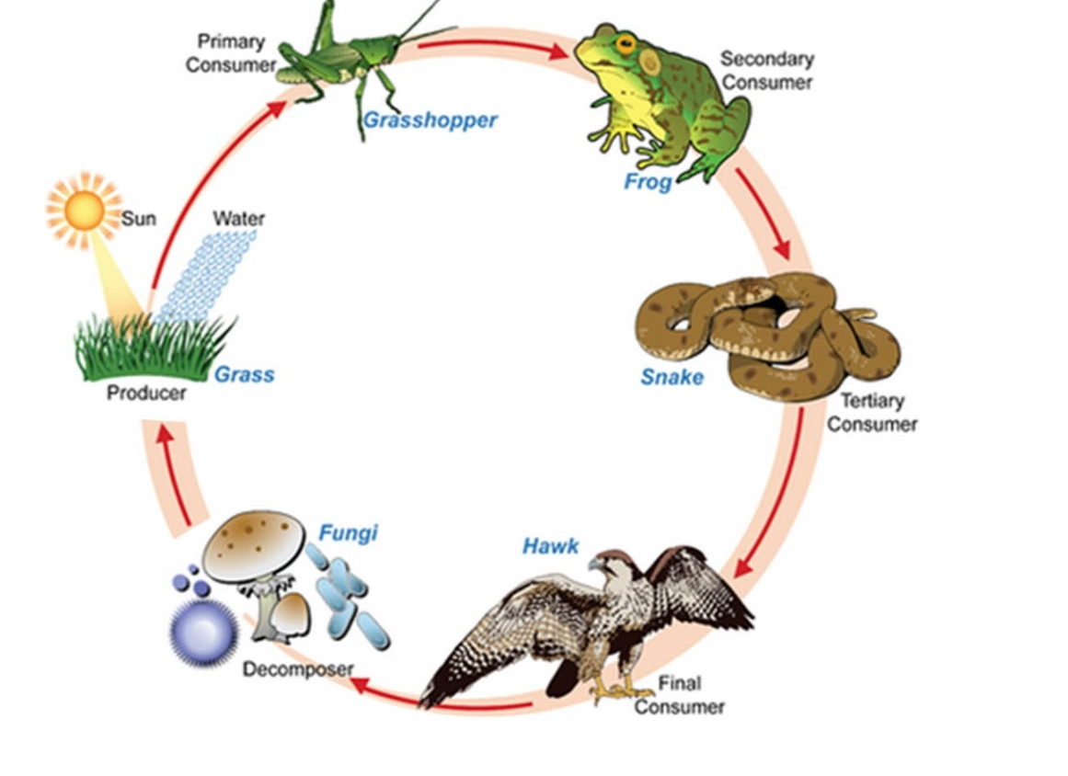
However, we know that, when one form of energy is changed to another, some energy is lost to the environment in forms which cannot be used again.
Energy

Slide 3
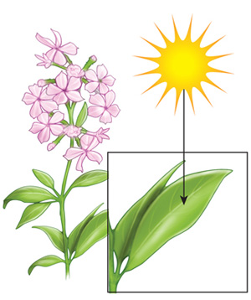
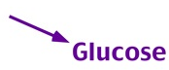
The green plants in a terrestrial ecosystem capture about 1% of the energy of sunlight that falls on their leaves and convert it into food energy.
1 %

Slide 4
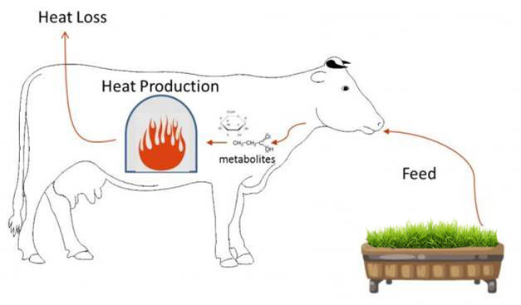
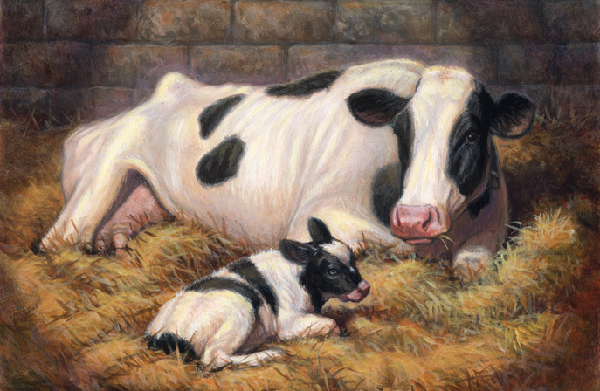
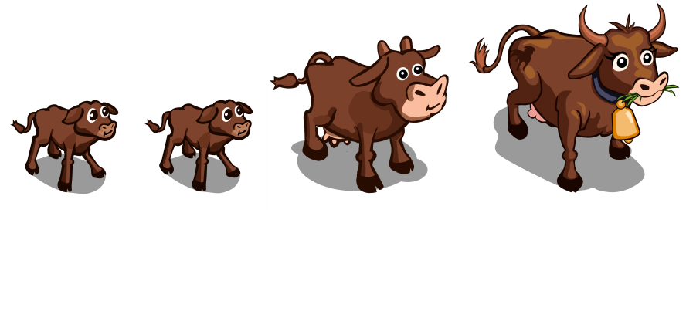
When green plants are eaten by primary consumers, a great deal of energy is lost as heat to the environment, some amount goes into digestion and in doing work and the rest goes towards growth and reproduction.

Slide 5

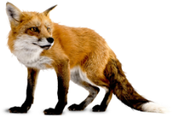
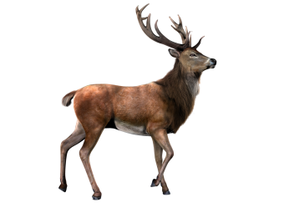


Only 10% amount of organic matter that is present at each step and reaches the next level of consumers.
1 Units
10 %
10 Units
10 %
100 Units
10 %
1000 Units

Slide 6
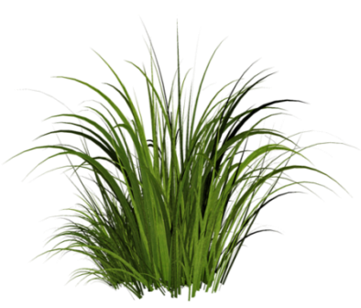
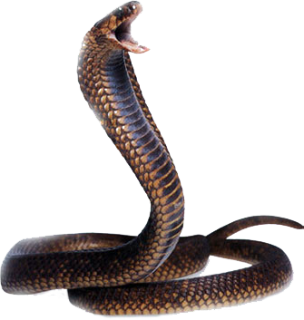
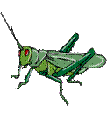
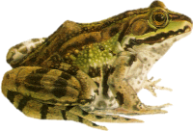
Food chains generally consist of only three or four steps.
Since so little energy (Only 10% amount of organic matter) is available for the next level of consumers,
Grass
Grasshoper
Frog
Snake
First tropic level
Second tropic level
Third tropic level
Fourth tropic level

Slide 7

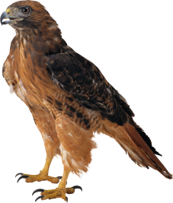
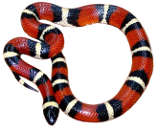
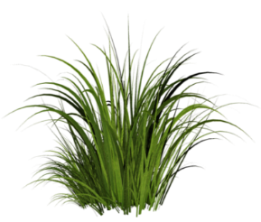
The loss of energy at each step is so great that very little usable energy remains after four trophic levels.
Heat
Heat
Heat
0.01%
10%
0.1%
1%

Slide 8




There are generally a greater number of individuals at the lower trophic levels of an ecosystem, the greatest number is of the producers.
Producers

Slide 9
Thank You

